Slide 1
BSTACK DEMO WEBSITE
Under Guidance of Mrs. Vaishali Sonanis Mam.
By : Ravi Yasaswini

Slide 2
INTRODUCTION
bstackdemo is a sample e-commerce web application created by Browser Stack for practicing and demonstrating automation testing.
The website simulates a real-world shopping platform where users can browse products, apply filters, view product details, add items to the cart, and proceed to checkout.
It is designed to provide testers and developers with a safe environment to build, execute, and validate automated test scripts using tools and frameworks like Selenium, Cucumber BDD, TestNG, JUnit, and Jenkins.

Slide 3
Responsibilities
Designed test cases for different modules of the browser stack demo website (login, Search, Cart , orders, offers, etc.).
Identified and tracked defects by preparing detailed defect report.
Executed all the testcases.
Create Defect Report.

Slide 4
OVERVIEW
bstackdemo.com is a sample e-commerce website developed by Browser Stack to help users practice web automation testing.
It simulates an online shopping platform where users can browse products, filter by categories, view details, and add items to the cart.
The site supports login functionality and checkout flows, making it suitable for testing end-to-end scenarios.
It allows testers and developers to validate different automation frameworks like Selenium, Cucumber, TestNG, and Jenkins in a safe environment.

Slide 5
MODULES
MODULE 1: SIGN-IN PAGE
Checked all the functionalities on the Sign In page including username, password, and login validation.
MODULE 2: SEARCH MODULE
Verified the product search functionality including search bar, auto-suggestions, and search results display.
MODULE 3: CART PAGE
Checking add to cart, remove from cart, update quantity, and view cart summary functionalities whether it updating or not correctly.

Slide 6
MODULE 4: FAVOURITES PAGE
Checking add ,remove and view favourites list functionalities whether they update correctly.
MODULE 5: OFFERS PAGE
Verifying available offers, discounts, and applied coupon functionalities whether they reflect properly on checkout.
MODULE 6: ORDERS PAGE
Checking order history, order details, and status tracking functionalities for correct updates.
MODULE 7: VENDORS PAGE
Checking vendor/brand listing, product display under vendors, and filter functionalities for accuracy.

Slide 7
MODULE 8: LOGOUT PAGE
Validating logout functionality to ensure secure session termination and redirection to login page.
MODULE 9: SUBSCRIBE EMAIL PAGE
Checking email subscription functionality by entering valid/invalid emails, verifying confirmation, and ensuring updates are reflected correctly.
MODULE 10: SHIPPING ADDRESS PAGE
Verifying add, update, delete, and select shipping address functionalities whether they save and reflect correctly.

Slide 8
DEFECTS
While running a testcase at certain point some fields are not working as it is expected which is nothing but a defect, so I have created a Defect report on those defects.

Slide 9
Defect identifier :- def_001
Ø Defect summary :- In search, Product list shows as per the input but it is navigating to home page .i.e. search functionality fails
Ø Test Id :- TC_001
Ø Test case name :- TC _ search
Ø Module name :- Search page
Ø Reproducible :- when we input a particular product in search field ,Product list shows related products
Ø Severity :- high
Ø Priority :- high
Ø Raised by :- Yasaswini
Ø Assigned to :- Developer
Ø Date of assignment :- 08-09-2025
Ø Status :- PENDING
Ø Snap shots :-
Ø Fixed by :- developer
Ø Date of fixing :-

Slide 10
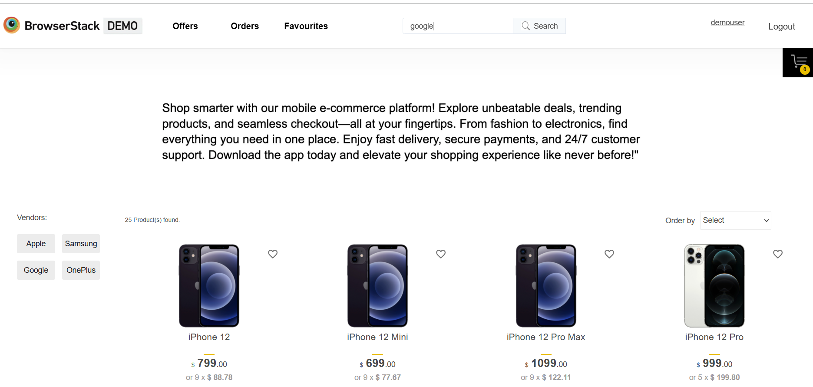

Slide 11
Defect identifier :- def_002
Ø Defect summary :- To subscribe news letter, the input field should only accept valid email but its accepting invalid mail
Ø Test Id :- TC_003
Ø Test case name :- TC _ subscribe email
Ø Module name :- Subscribe email page
Ø Reproducible :- To subscribe news letter, the input field should only accept valid email
Ø Severity :- medium
Ø Priority :- medium
Ø Raised by :- Yasaswini
Ø Assigned to :- Developer
Ø Date of assignment :- 08-09-2025
Ø Status :- PENDING
Ø Snap shots :-
Ø Fixed by :- developer
Ø Date of fixing :-

Slide 12
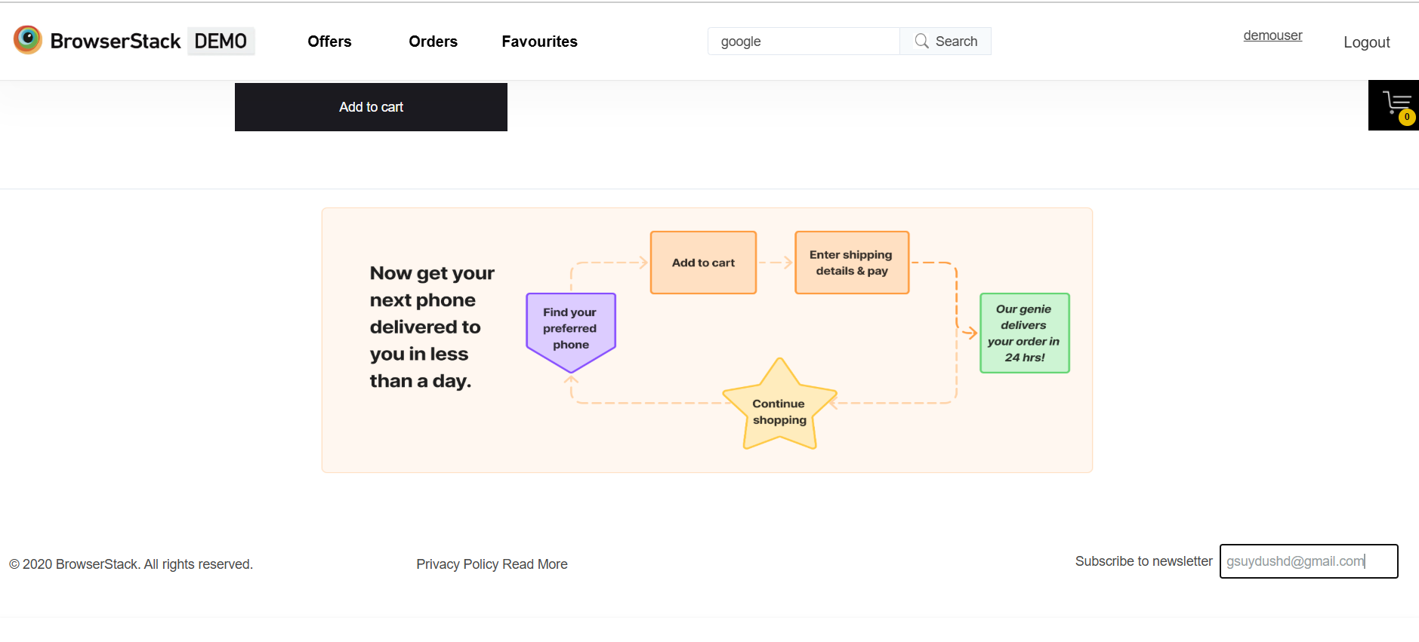

Slide 13
CHALLENGES
Test Execution: Sometimes scripts passed and sometimes failed due to synchronization issues while interacting with dynamic elements.
Handling Waits: Initially, I used Thread . sleep(), but it slowed down the scripts. Later, I implemented implicit waits for dynamic elements, which made execution more stable.
The login module was challenging to identifying and handling locators effectively.

Slide 14
EXPERIENCE
This project helped me to improve my test case writing skills, as I had to think about every possible scenario .
Identified multiple defects during manual and automation testing, which improved my bug reporting skills.
Manual testing require strong observation , so I practised applying all possible input combinations.
Automation testing with selenium and TestNG taught me how to design test scripts, handle waits effectively.
Integrated the test suite with Jenkins to schedule builds, execute test cases automatically, and generate execution reports.

Slide 15
Thank You!!!
Vaishali Mam For Guiding Us through out the Project

